Slide 1
INTRODUCTION TO FYE 1001
Chapter 1

Slide 2
CHAPTER OBJECTIVES
Understand the value of the First-Year Experience
Take a look at the first-year student at Tech.
Get and overview of what to expect in FYE 1001.

Slide 3
“Loyalty isn't automatic, it's earned. During your time here, you will feel our devotion to your development and when you walk across the stage with your degree, you will know exactly what it means to Ever Loyal Be.” DR. JIM HENDERSON, LOUISIANA TECH PRESIDENT

Slide 4

What is FYE 1001, and why do we have to take it?
FYE 1001 is key to ensuring you receive the support and resources you need to thrive during your transition to university life.

Slide 5
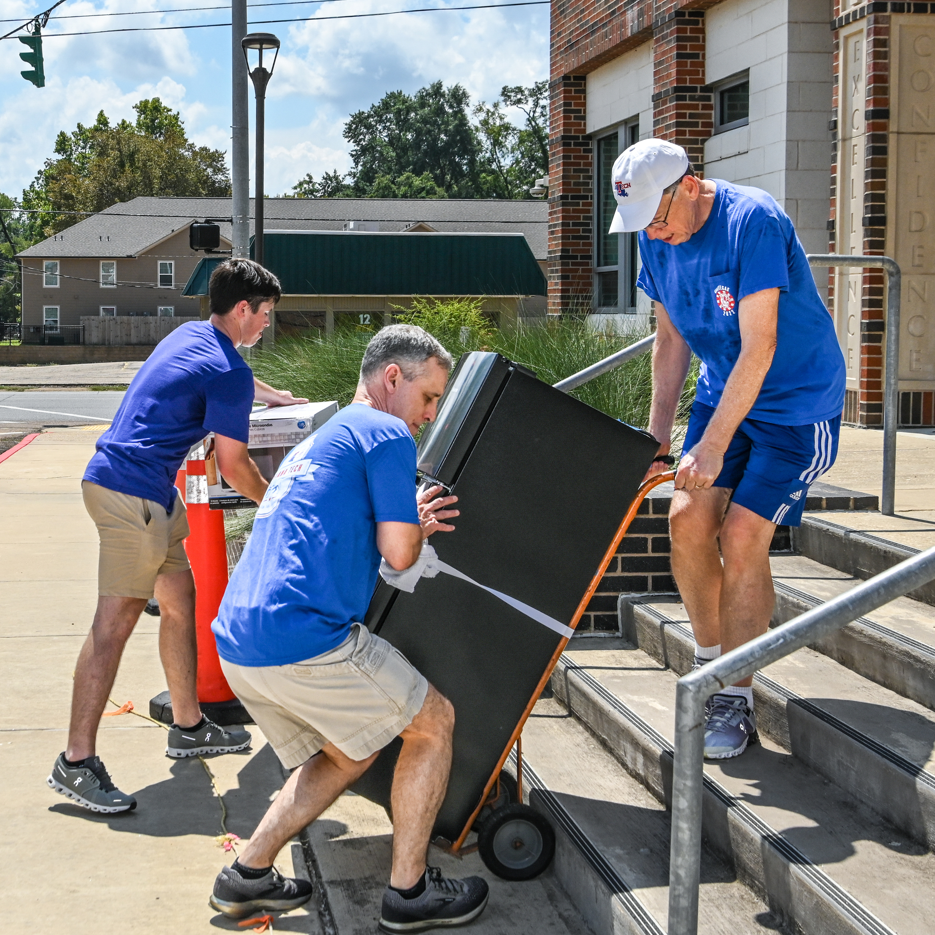




Ease your transition to college
Help you connect with other students
How will FYE 1001 help me?
Introduce you to campus resources
Learn important policies & procedures

Slide 6
Why FYE 1001?
Improve Interpersonal Skills
Develop essential communication and leadership abilities, such as effective verbal and nonverbal communication, active listening, and small group interactions.
Recognize Cultural Diversity
Enhance understanding and appreciation for diverse social, organizational, and multicultural perspectives through team-building activities
Enhance Critical Thinking
Cultivate critical evaluation skills related to media literacy and associated ethical considerations.

Slide 7
What does the first-year student look like at Louisiana Tech?

Slide 8
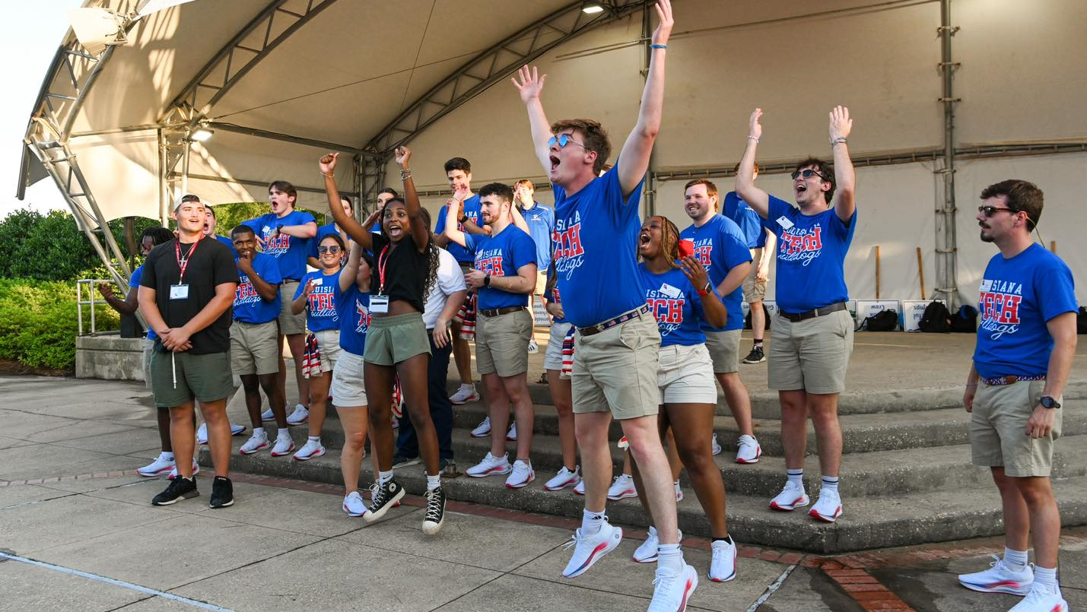

Slide 9


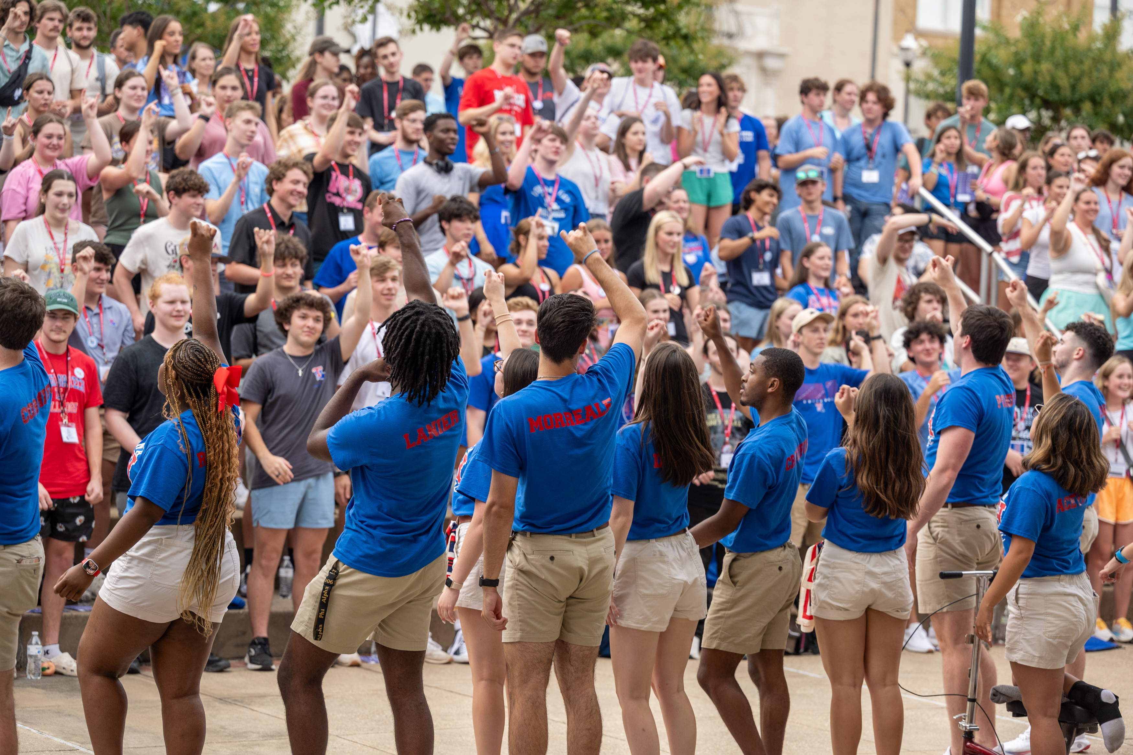
The First-Year Student at Tech
55% Male
45% Female
47 States
60 Countries
Largest Incoming Class

Slide 10
What will class look like?
8 Weeks
Discussions and activities
Opportunities to reflect on your journey to college and the road ahead.

Slide 11
In Class Activity (1.2)
Now that you are a college student, your mind is probably filled with many questions about Tech specifically, or college life in general. Take a moment and write down 2 – 3 questions to be turned in. We will answer these throughout the quarter!

